Slide 1
USA Housing - Machine Learning(Linear Regression)
NAME :- Omkaraiah
PGDA25

Slide 2
The data contains the following columns:
Avg. Area Income: - Avg. Income of residents of the city house is located in.
Avg. Area House Age:- Avg Age of Houses in same city
Avg. Area Number of Rooms:- Avg Number of Rooms for Houses in same city
Avg. Area Number of Bedrooms: -Avg Number of Bedrooms for Houses in same city
Area Population:- Population of city house is located in
Price: -Price that the house sold at
Address-: Address for the house

Slide 3
Data.head()
Avg. Area Income | Avg. Area House Age | Avg. Area Number of Rooms | Avg. Area Number of Bedrooms | Area Population | Price | Address
0 | 79545.458574 | 5.682861 | 7.009188 | 4.09 | 23086.800503 | 1.059034e+06 | 208 Michael Ferry Apt. 674\nLaurabury, NE 3701...
1 | 79248.642455 | 6.002900 | 6.730821 | 3.09 | 40173.072174 | 1.505891e+06 | 188 Johnson Views Suite 079\nLake Kathleen, CA...
2 | 61287.067179 | 5.865890 | 8.512727 | 5.13 | 36882.159400 | 1.058988e+06 | 9127 Elizabeth Stravenue\nDanieltown, WI 06482...
3 | 63345.240046 | 7.188236 | 5.586729 | 3.26 | 34310.242831 | 1.260617e+06 | USS Barnett\nFPO AP 44820
4 | 59982.197226 | 5.040555 | 7.839388 | 4.23 | 26354.109472 | 6.309435e+05 | USNS Raymond\nFPO AE 09386

Slide 4
Data.describe()
Avg. Area Income | Avg. Area House Age | Avg. Area Number of Rooms | Avg. Area Number of Bedrooms | Area Population | Price
count | 5000.000000 | 5000.000000 | 5000.000000 | 5000.000000 | 5000.000000 | 5.000000e+03
mean | 68583.108984 | 5.977222 | 6.987792 | 3.981330 | 36163.516039 | 1.232073e+06
std | 10657.991214 | 0.991456 | 1.005833 | 1.234137 | 9925.650114 | 3.531176e+05
min | 17796.631190 | 2.644304 | 3.236194 | 2.000000 | 172.610686 | 1.593866e+04
25% | 61480.562388 | 5.322283 | 6.299250 | 3.140000 | 29403.928702 | 9.975771e+05
50% | 68804.286404 | 5.970429 | 7.002902 | 4.050000 | 36199.406689 | 1.232669e+06
75% | 75783.338666 | 6.650808 | 7.665871 | 4.490000 | 42861.290769 | 1.471210e+06
max | 107701.748378 | 9.519088 | 10.759588 | 6.500000 | 69621.713378 | 2.469066e+06

Slide 5
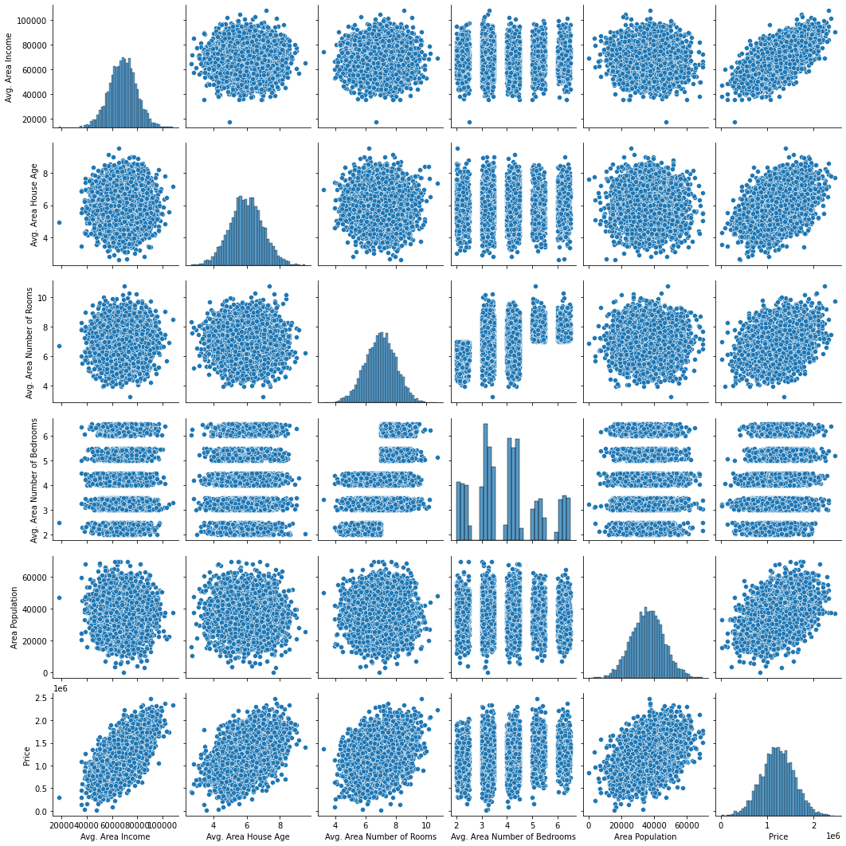
Sns.pairplot(data)

Slide 6
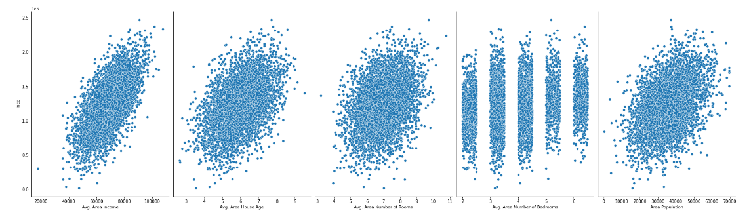
sns.pairplot(data, x_vars=['Avg. Area Income','Avg. Area House Age','Avg. Area Number of Rooms','Avg. Area Number of Bedrooms','Area Population'], y_vars='Price',height=7, aspect=0.7, kind='scatter')

Slide 7
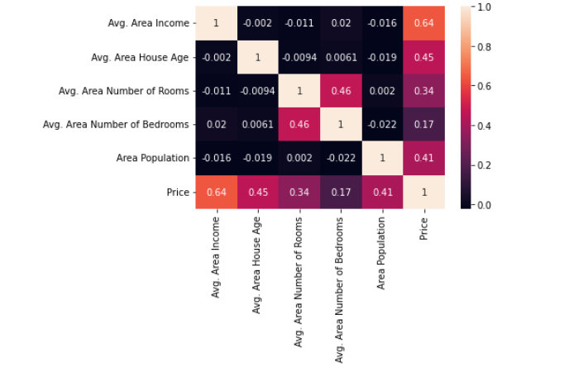
sns.heatmap(data.corr(),annot=True)

Slide 8
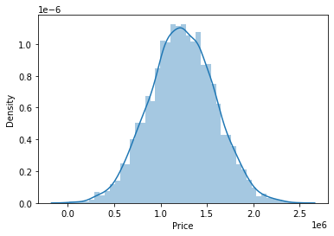
sns.distplot(data.Price)

Slide 9
coeff_df = pd.DataFrame(lm.coef_,X_test.columns,columns=['Coefficient']) coeff_df
 | Coefficient
0 | 229275.224032
1 | 163592.487140
2 | 120113.253351
3 | 3015.847572
4 | 150556.340296

Slide 10
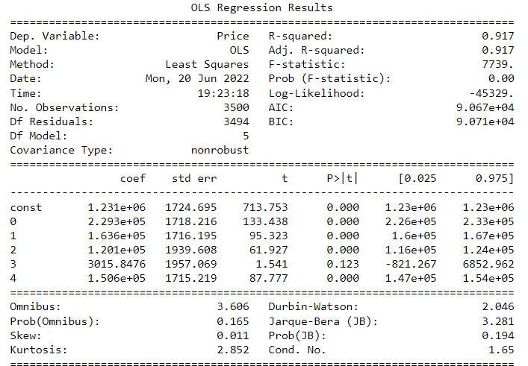

Slide 11
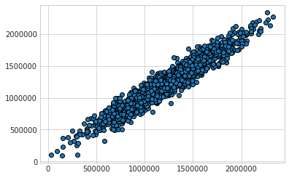
plt.scatter(y_test, y_pred, edgecolor='black')

Slide 12
print('MAE:', metrics.mean_absolute_error(y_test,y_pred)) print('MSE:', metrics.mean_squared_error(y_test, y_pred)) print('RMSE:', np.sqrt(metrics.mean_squared_error(y_test, y_pred)))
MAE: 79830.143300125
MSE: 9823431323.317669
RMSE: 99113.22476500132

